Slide 1

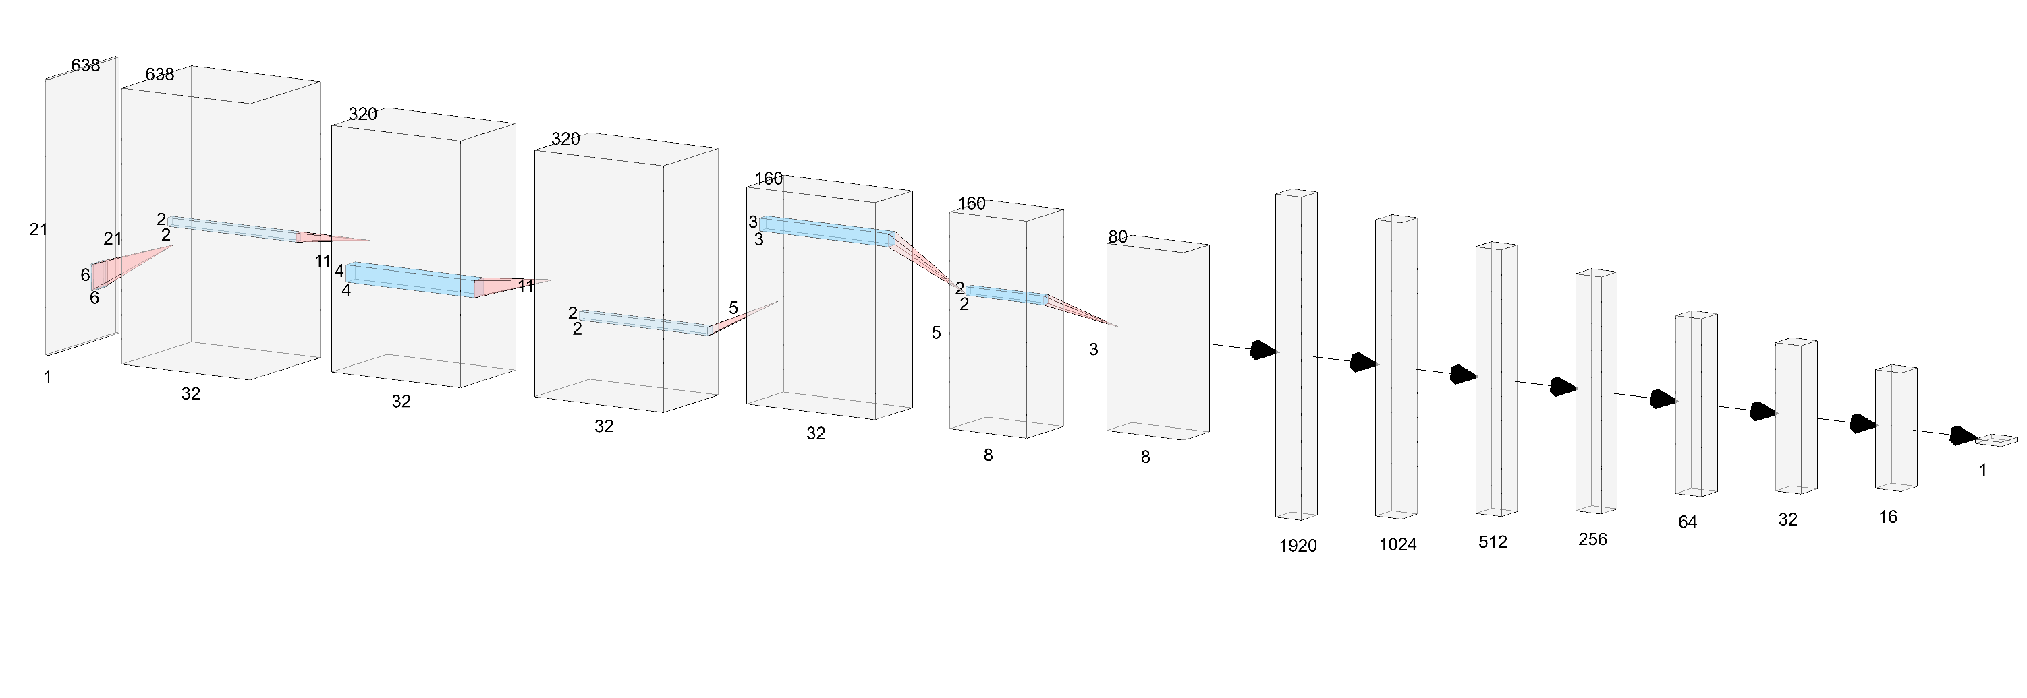
B-scan
conv
pool
conv
pool
conv
pool
fc1
fc2
fc3
fc4
fc5
fc6
Defect Angle

